Slide 1

Cognee.ai: Building Persistent Memory for AI Agents
A comprehensive exploration of cognitive architecture for intelligent agent applications

Slide 2

The Problem: LLMs Lack Memory & Context
Stateless by Design
RAG Limitations
Large Language Models are powerful but inherently stateless. They don't remember past interactions or access your specific, private data without explicit provision in each query.
Basic Retrieval-Augmented Generation finds semantically similar text chunks using vector search, but treats information in isolation, missing crucial relationships between concepts.
Fragmented Answers
Information exists in silos, requiring users or LLMs to manually piece together context from disparate chunks.
Limited Synthesis
Struggles with questions requiring multi-document synthesis or understanding structural relationships in complex documentation.

Slide 3
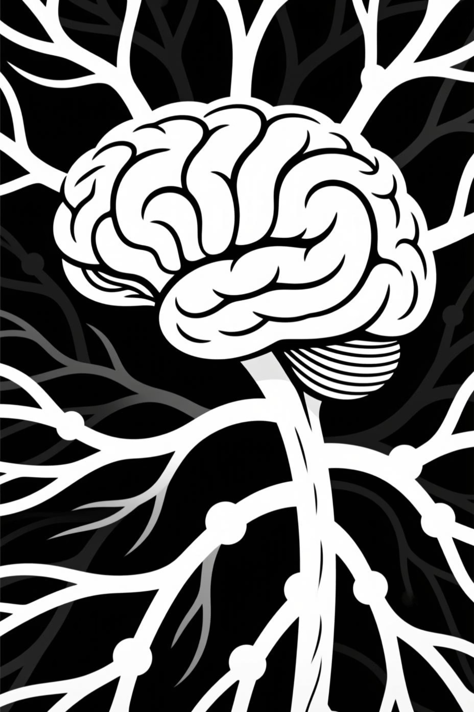
What is Cognee.ai?
AI Memory Engine
Beyond Simple RAG
A cognitive architecture framework designed to build a persistent, structured, and queryable "brain" or memory layer for AI applications and intelligent agents.
Goes far beyond basic retrieval by truly understanding data, not merely finding similar text patterns. Transforms information into actionable intelligence.
Intelligent Knowledge Network
Organises disparate data sources into a cohesive, interconnected knowledge graph that mirrors human cognitive understanding of relationships and context.

Slide 4



How Cognee Works: The ECL Pipeline & Hybrid Storage
Extract
Cognify
Load
Ingests data from diverse sources including APIs, databases, PDFs, text files, audio recordings, code repositories, and images.
The core intelligence process that chunks data, generates vector embeddings, extracts entities and relationships, then builds a comprehensive knowledge graph.
Stores processed information into a sophisticated hybrid backend combining vector, graph, and relational storage systems.
Vector Store
Graph Store
Relational Store
Enables semantic similarity search using embeddings, similar to traditional RAG approaches.
Captures entities and their relationships for structural understanding and multi-hop reasoning.
Tracks metadata, document sources, and maintains complete data provenance.

Slide 5


Key Capabilities
Multi-Modal Ingestion
Automated Graph Construction
Hybrid Search
Seamlessly handles text, PDFs, audio (via transcription), images (via OCR), SQL databases, code repositories, and more across diverse formats.
Intelligently transforms unstructured and structured data into a rich network of entities and relationships without manual intervention.
Combines vector similarity with graph traversal to deliver richer, more accurate context retrieval than traditional methods.
Contextual Understanding
Persistent Memory
Discovers not just what is relevant, but precisely how different pieces of information interconnect and relate.
Creates a long-term, queryable knowledge base that AI agents can reference and build upon over time.

Slide 6
Use Cases
Enhanced Enterprise Search
AI Agent Memory
Data Analysis & Insights
Provide agents with long-term, structured memory to improve reasoning and task completion, such as customer support bots remembering past interactions.
Discover hidden relationships and emerging patterns in large, complex datasets that traditional analysis methods would miss.
Find comprehensive answers requiring synthesis across multiple documents and formats, dramatically improving knowledge discovery.
Compliance & Due Diligence
Documentation Intelligence
Quickly answer complex questions requiring cross-referencing of DDQs, audit reports, meeting notes, and regulatory documents - directly relevant to Diligence Vault workflows.
Understand codebases or technical documentation by automatically mapping dependencies, concepts, and architectural relationships.

Slide 7
Usage & Integration
01
02
Installation
Data Ingestion
Available as a Python library via pip, supporting Python 3.9 through 3.12 for broad compatibility.
Use await cognee.add() to ingest text, files, or URLs into the system for processing.
03
04
Knowledge Building
Querying
Execute await cognee.cognify() to process ingested data and construct the knowledge graph.
Retrieve insights with await cognee.search() using various strategies tailored to your needs.
Configuration
API / MCP Server
Uses environment variables or .env files for API keys (LLM, embeddings) and database connections. Defaults often employ local file-based databases like SQLite, LanceDB, and Kuzu for straightforward setup.
Can be deployed as a server (via Docker) exposing an API, potentially using the Model Context Protocol (MCP) for seamless integration with AI clients like Cursor or Continue.

Slide 8
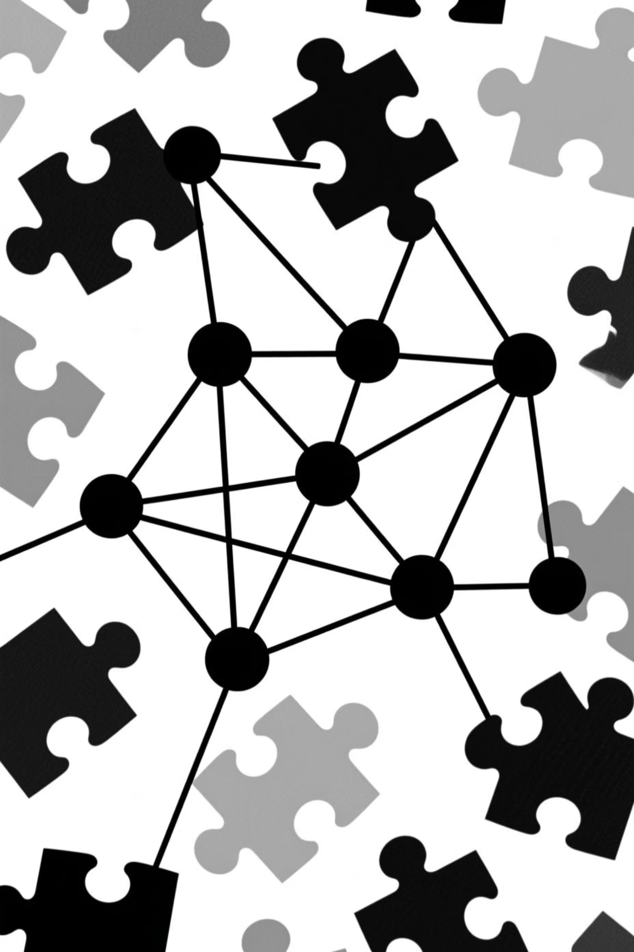
Key Differentiator: Knowledge Graph vs. "Bag of Chunks"
Pure RAG Approach
Cognee Approach
Creates a searchable index of isolated text chunks - essentially a "bag of chunks". Relies heavily on semantic similarity alone, treating each piece of information independently.
Creates a structured knowledge graph representing entities and their interconnected relationships. Enables deep understanding of how information connects, not just what sounds similar.
Limited context awareness
Isolated information fragments
Multi-hop reasoning capabilities
Surface-level matching
Relationship-aware synthesis
No relationship mapping
Contextual understanding
Structural intelligence

Slide 9

Benefits
Reduced Hallucinations
Deeper Insights
Grounds LLM responses in factual, interconnected data, significantly improving accuracy and reliability of generated content.
Uncovers relationships and patterns that simple vector search would miss, enabling more profound understanding of your data.
Persistent & Evolving Memory
Creates a long-term knowledge base that continuously learns and can be updated as new information becomes available.
Handles Complexity
Answers questions requiring sophisticated synthesis across multiple sources, formats, and data types with ease.
Scalability & Modularity
Engineered with flexible pipelines and pluggable backends to grow with your needs and adapt to changing requirements.

